Slide 1
Consistency and Replication

Slide 2
Distributed Systems
Major issues:
  Transparency
  Scalability

Slide 3
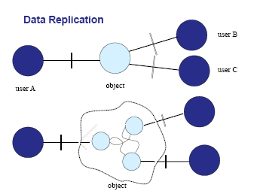

Slide 4
Why replication?
To enhance reliability
  If one replica is unavailable or crashes, use another
  Protect against corrupted data
To improve performance
  Scale with size of the distributed system (replicated web servers)
  Scale in geographically distributed systems

Slide 5
Problems in replication?
  Having multiple copies may lead to consistency problems.
  To keep the replicas consistent: meaning if one copy is updated, we need to ensure that the other copies are updated as well, otherwise, the replica will no longer be the same.
To keep replicas consistent, we generally need to ensure that all conflicting operations are done in the same order everywhere
Conflicting operations: From the world of transactions:
Read–write conflict: a read operation and a write
operation act concurrently
Write–write conflict: two concurrent write operations

Slide 6
Consistency and Replication
  Exactly when and how the modifications need to be carried out determines the price of replication.
Price paid for replication- consistency problems, cached pages outdated, invalidate prev. pages
Guaranteeing global ordering on conflicting operations may be a costly operation, downgrading scalability

Slide 7
Replication Issues
When to replicate?
How many replicas to create?
Where should the replicas located?
How to maintain consistency?
Key issue: need to maintain consistency of replicated data

Slide 8
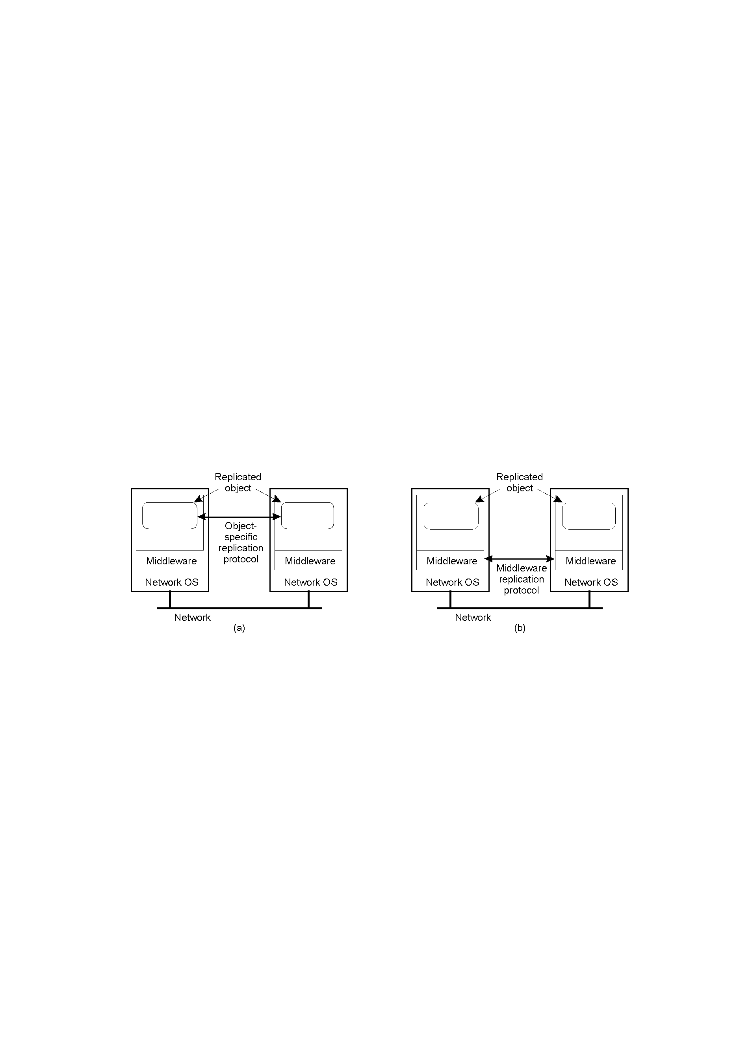
Object Replication
Approach 1: application is responsible for replication
  Application needs to handle consistency issues
Approach 2: system (middleware) handles replication
  Consistency issues are handled by the middleware
  Simplifies application development but makes object-specific solutions harder

Slide 9
Replication and Scaling
Replication and caching used for system scalability
Multiple copies:
  Improves performance by reducing access times
  But higher network overheads of maintaining consistency
  Example: object is replicated N times
    Read frequency R, write frequency W
    If R<<W, high consistency overhead and wasted messages
    Consistency maintenance is itself an issue
      What semantics to provide?
      Tight consistency requires globally synchronized clocks!
Solution: loosen consistency requirements
  Variety of consistency semantics possible

Slide 10
Consistency models
  Consistency models
    Data-centric consistency models
    Client-centric consistency models

Slide 11
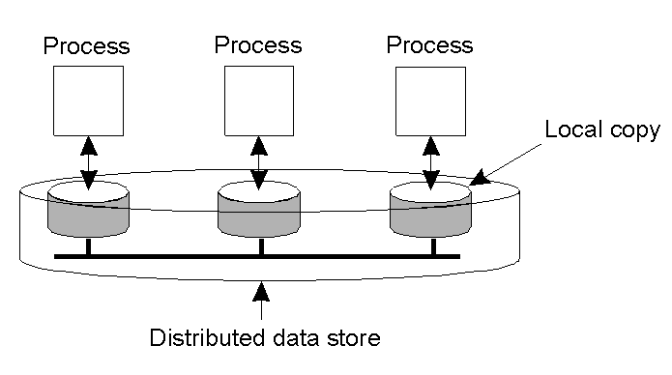
Data-Centric Consistency Models
Consistency model (aka consistency semantics)
  Contract between processes and the data store
    If processes obey certain rules, data store will work correctly
  All models attempt to return the results of the last write for a read operation
    Differ in how “last” write is determined/defined

Slide 12
Strict Consistency
Any read always returns the result of the most recent write
  Implicitly assumes the presence of a global clock
  A write is immediately visible to all processes
    Difficult to achieve in real systems (network delays can be variable)

Slide 13

Strict Consistency
Behavior of two processes, operating on the same data item.
A strictly consistent store.
A store that is not strictly consistent.
Thus in a strictly consistent data store, all writes are instantaneously visible to all processes and an absolute global time is maintained.

Slide 14
Sequential Consistency
Strict consistency- impossible to implement
Programmer can manage well with weaker models
When events in the same process occur very quickly, such that the process is not able to do something else, then the order of statement does not matter.
When order is essential-semaphores and other synch. Methods used.
Hence learn to live with weaker consistency.

Slide 15
Sequential Consistency
The result of any execution is the same as if the (read and write) operations by all processors on the data were executed in some sequential order and the operations of each individual process appear in this sequence in the order specified by its program.
When processes run concurrently on different m/cs, any valid interleaving of read and write operations is acceptable, but all processes see the same interleaving of operations

Slide 16
Sequential Consistency
Sequential consistency: weaker than strict consistency
  Assumes all operations are executed in some sequential order and each process issues operations in program order
    Any valid interleaving is allowed
    All agree on the same interleaving
    Each process preserves its program order
    Nothing is said about “most recent write”

Slide 17
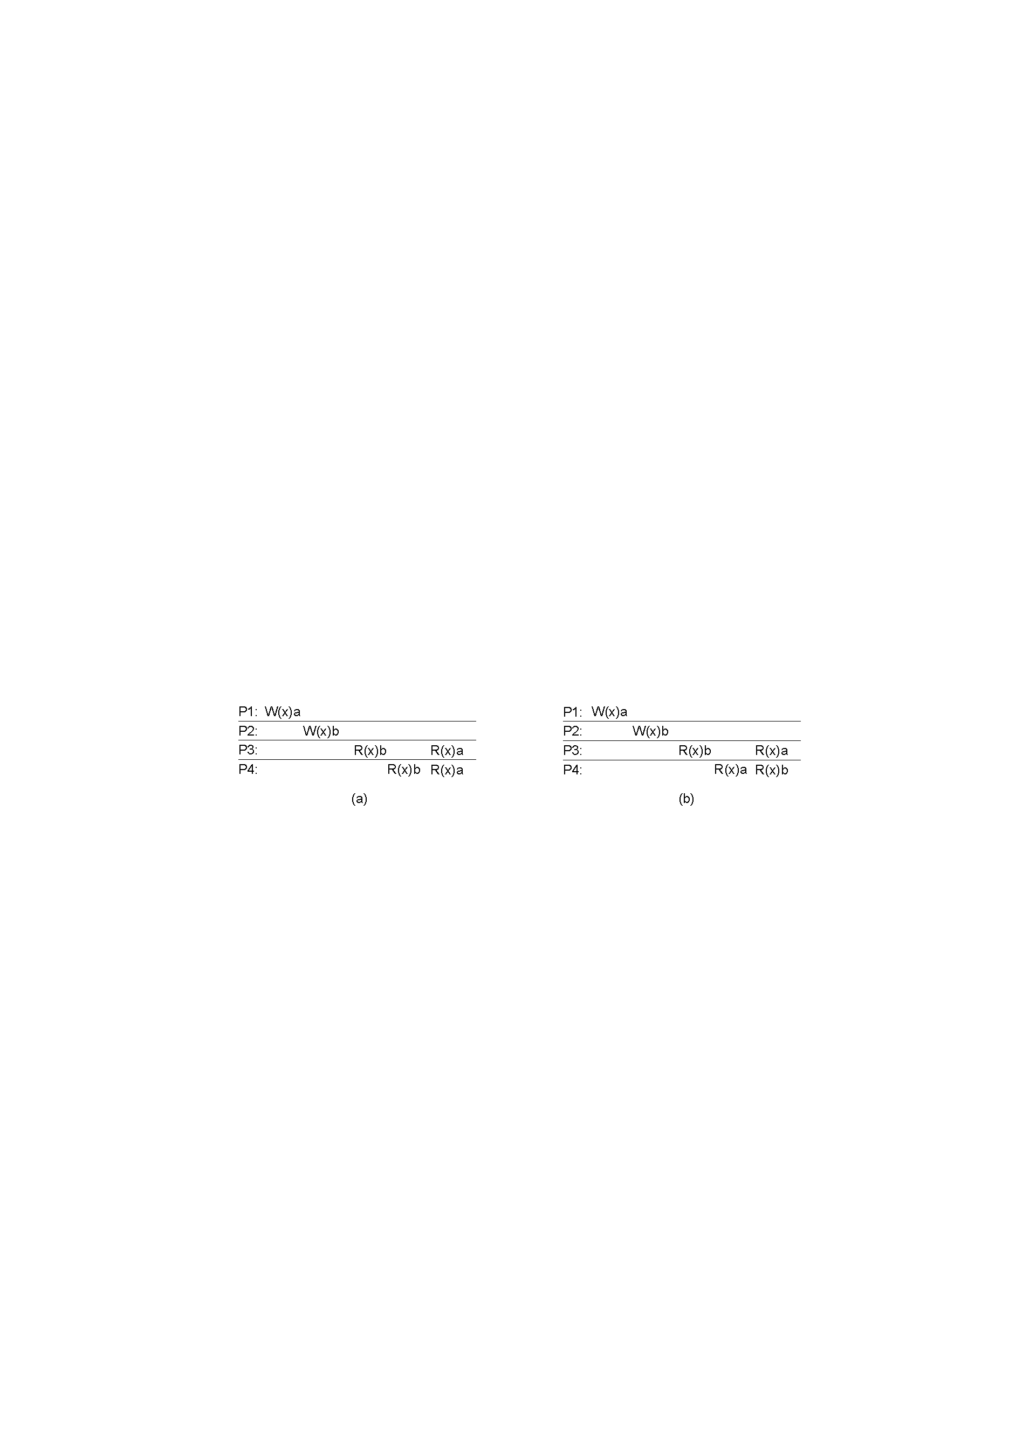
Sequential Consistency
A sequentially consistent data store.
A data store that is not sequentially consistent.

Slide 18
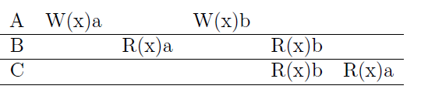
Is the following data store sequentially consistent?

Slide 19
Linearizability
Weaker than strict but stronger than sequential
Operations are assumed to receive a timestamp using a globally available clock, but with finite precision. (i.e. with the assumption that processes use loosely synch. Clocks)
Assumes sequential consistency and
  If TS(x) < TS(y) then OP(x) should precede OP(y) in the sequence

Slide 20
Linearizability
  Stronger than sequential consistency
  Difference between linearizability and serializbility?
    Granularity: reads/writes versus transactions
Example: assignment : write operation (atomic)
print : read operation (atomic)
Process P1 | Process P2 | Process P3
x = 1; print ( y, z); | y = 1; print (x, z); | z = 1; print (x, y);

Slide 21
Linearizability and Sequential Consistency Example
Four valid execution sequences for the processes of the previous slide. The vertical axis is time.
x = 1; print (y, z); y = 1; print (x, z); z = 1; print (x, y); Prints: 001011 Signature: 001011 (a) | x = 1; y = 1; print (x,z); print(y, z); z = 1; print (x, y); Prints: 101011 Signature: 101011 (b) | y = 1; z = 1; print (x, y); print (x, z); x = 1; print (y, z); Prints: 010111 Signature: 110101 (c) | y = 1; x = 1; z = 1; print (x, z); print (y, z); print (x, y); Prints: 111111 Signature: 111111 (d)

Slide 22
Is 000000 possible ?
Is 001001 permitted?

Slide 23
Consider the following programs executes by P1 and P2
P1: {initially x=0} x :=1; print y
P2: {initially y=0} y :=1; print x
If sequential consistency is maintained, then what value(s) of (x, y) will never be printed?

Slide 24
Linearizability and Sequential Consistency
Various valid statement orderings may produce different program results that are allowed under the assumption of sequential consistency.
The contract between processes and distributed shared data store is that the processes must accept all of these as valid results.

Slide 25
Causal Consistency
Necessary condition:
-Writes that are potentially casually related must be seen by all processes in the same order.
-Concurrent writes may be seen in a different order on different machines.

Slide 26
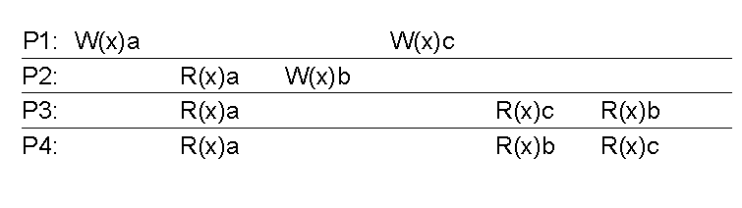
Causal Consistency
This sequence is allowed with a casually-consistent store, but not with sequentially or strictly consistent store.

Slide 27
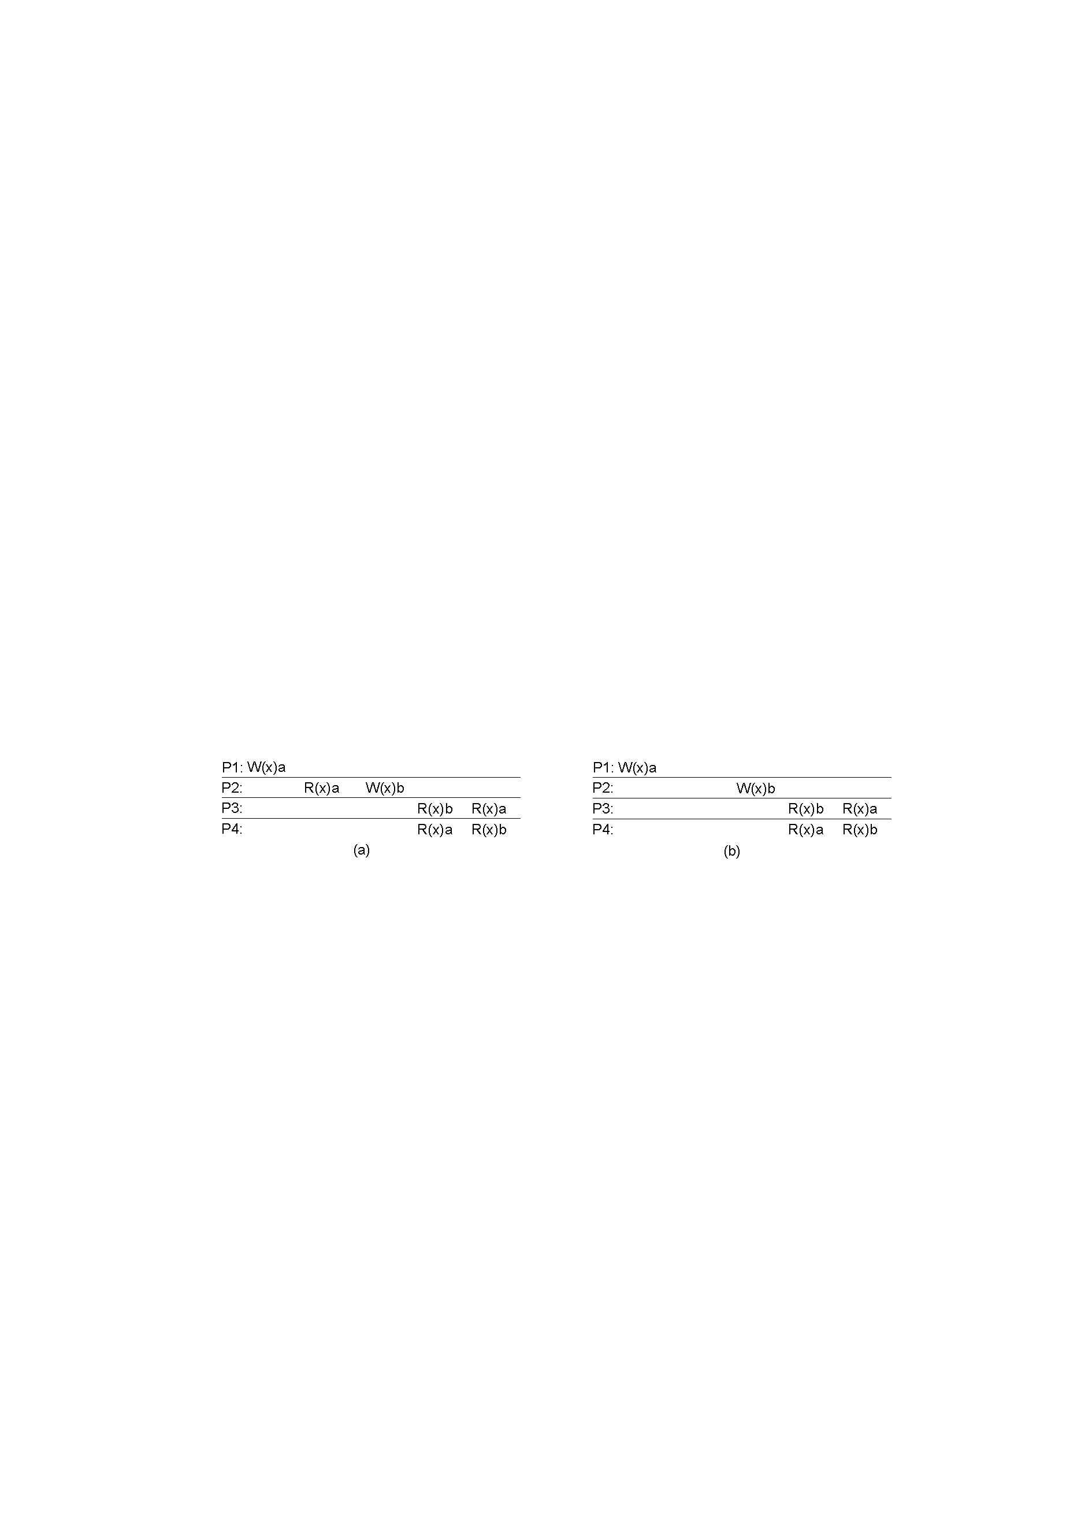
Causal Consistency
A violation of a casually-consistent store.
A correct sequence of events in a casually-consistent store.

Slide 28
FIFO Consistency
Necessary Condition:
Writes done by a single process are seen by all other processes in the order in which they were issued, but writes from different processes may be seen in a different order by different processes.
Relaxes causal consistency
Simple implementation: tag each write by (Proc ID, seq #)

Slide 29

FIFO Consistency
A valid sequence of events of FIFO consistency

Slide 30
FIFO Consistency
x = 1; print (y, z); y = 1; print(x, z); z = 1; print (x, y); Prints: 00 (a) P1’s view | x = 1; y = 1; print(x, z); print ( y, z); z = 1; print (x, y); Prints: 10 (b) P2’s view | y = 1; print (x, z); z = 1; print (x, y); x = 1; print (y, z); Prints: 01 (c) P3’s view
Statement execution as seen by the three processes from the previous slide. The statements in bold are the ones that generate the output shown.

Slide 31
FIFO Consistency
Process P1 | Process P2
x = 1; if (y == 0) kill (P2); | y = 1; if (x == 0) kill (P1);
Two concurrent processes.

Slide 32
The key difference between sequential consistency and FIFO consistency is that with the former , although the order of statement execution is non-deterministic, atleast all processes agree what it is. With the latter, they need not agree

Slide 33
Other models
Even FIFO consistency may be too strong!
  Requires all writes from a process be seen in order
Assume use of critical sections for updates
  Send final result of critical section everywhere
  Do not worry about propagating intermediate results
    Assume presence of synchronization primitives to define semantics

Slide 34
Weak Consistency
Properties:
Accesses to synchronization variables associated with a data store are sequentially consistent
No operation on a synchronization variable is allowed to be performed until all previous writes have been completed everywhere
No read or write operation on data items are allowed to be performed until all previous operations to synchronization variables have been performed.

Slide 35
Weak Consistency
Unlike previous models, weak consistency enforces consistency on a group of operations, not on individual reads and writes
It only limits the time when consistency holds, rather than the form of consistency

Slide 36
Weak Consistency
int a, b, c, d, e, x, y; /* variables */
int *p, *q; /* pointers */
int f( int *p, int *q); /* function prototype */
a = x * x; /* a stored in register */
b = y * y; /* b as well */
c = a*a*a + b*b + a * b; /* used later */
d = a * a * c; /* used later */
p = &a; /* p gets address of a */
q = &b /* q gets address of b */
e = f(p, q) /* function call */
A program fragment in which some variables may be kept in registers.

Slide 37
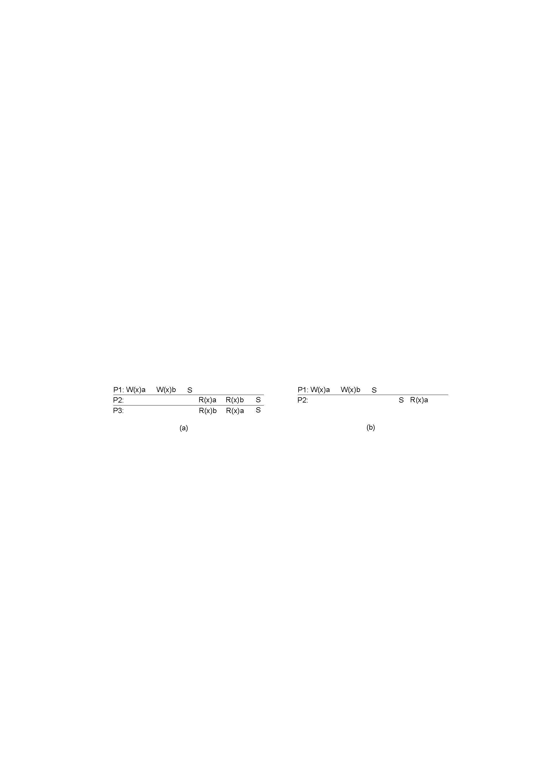
Weak Consistency
A valid sequence of events for weak consistency.
An invalid sequence for weak consistency.

Slide 38
Other Models
Entry and release consistency
  Assume shared data are made consistent at entry or exit points of critical sections

Slide 39

Release Consistency
A valid event sequence for release consistency.

Slide 40
Release Consistency
Rules:
Before a read or write operation on shared data is performed, all previous acquires done by the process must have completed successfully.
Before a release is allowed to be performed, all previous reads and writes by the process must have completed
Accesses to synchronization variables are FIFO consistent (sequential consistency is not required).

Slide 41
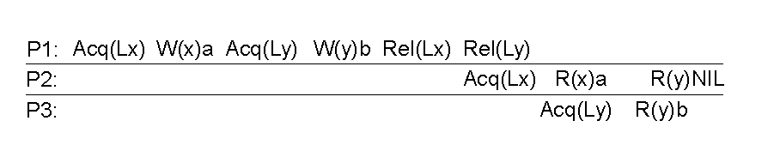
Entry Consistency
A valid event sequence for entry consistency.

Slide 42
Entry Consistency
Conditions:
An acquire access of a synchronization variable is not allowed to perform with respect to a process until all updates to the guarded shared data have been performed with respect to that process.
Before an exclusive mode access to a synchronization variable by a process is allowed to perform with respect to that process, no other process may hold the synchronization variable, not even in nonexclusive mode.
After an exclusive mode access to a synchronization variable has been performed, any other process's next nonexclusive mode access to that synchronization variable may not be performed until it has performed with respect to that variable's owner.

Slide 43
Summary of Data-centric Consistency Models
Consistency | Description
Strict | Absolute time ordering of all shared accesses matters.
Linearizability | All processes must see all shared accesses in the same order. Accesses are furthermore ordered according to a (non unique) global timestamp
Sequential | All processes see all shared accesses in the same order. Accesses are not ordered in time
Causal | All processes see causally-related shared accesses in the same order.
FIFO | All processes see writes from each other in the order they were used. Writes from different processes may not always be seen in that order
 | (a)
Consistency | Description
Weak | Shared data can be counted on to be consistent only after a synchronization is done
Release | Shared data are made consistent when a critical region is exited
Entry | Shared data pertaining to a critical region are made consistent when a critical region is entered.
 | (b)

